Slide 1

18CSC207J – Advanced Programming Practice
C.Arun, Asst. Prof. Dept of Software Engineering, School of Computing, SRMIST

Slide 2

Functional Programming Paradigm

Slide 3
Introduction
Functional programming is a programming paradigm in which it is tried to bind each and everything in pure mathematical functions. It is a declarative type of programming style that focuses on what to solve rather than how to solve.
Functional programming paradigm is based on lambda calculus.
Instead of statements, functional programming makes use of expressions.
evaluation of an expression produces a value.
Functional programming is a declarative paradigm because it relies on expressions and declarations rather than statements. Unlike procedures that depend on a local or global state, value outputs in FP depend only on the arguments passed to the function.
Functional programming consists only of PURE functions.
In functional programming, control flow is expressed by combining function calls, rather than by assigning values to variables.
Example:

Slide 4
Characteristics of Functional Programming
Functional programming method focuses on results, not the process
Emphasis is on what is to be computed
Data is immutable
Functional programming Decompose the problem into 'functions
It is built on the concept of mathematical functions which uses conditional expressions and recursion to do perform the calculation
It does not support iteration like loop statements and conditional statements like If-Else
Functional programming languages are designed on the concept of mathematical functions that use conditional expressions and recursion to perform computation.
Functional programming supports higher-order functions and lazy evaluation features.
Functional programming languages don’t support flow Controls like loop statements and conditional statements like If-Else and Switch Statements. They directly use the functions and functional calls.

Slide 5
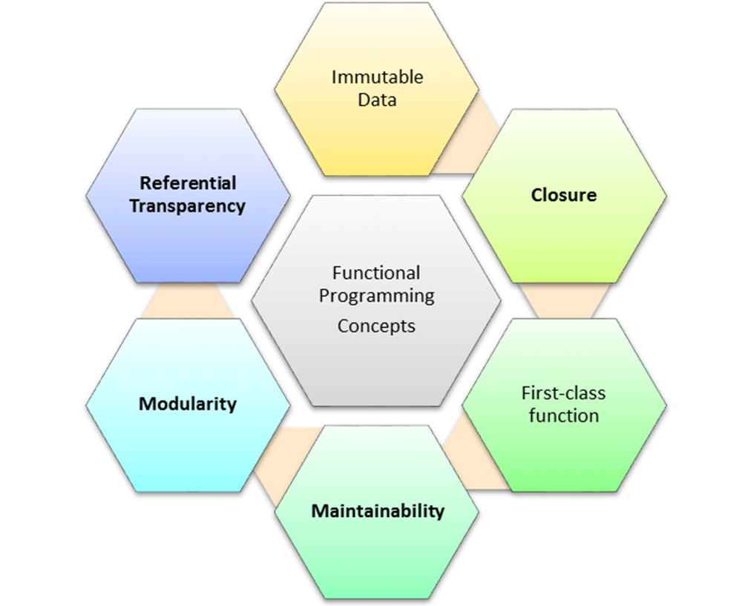
Concepts of FP
Pure functions
Recursion
Referential transparency
Functions are First-Class and can be Higher-Order
Immutability

Slide 6
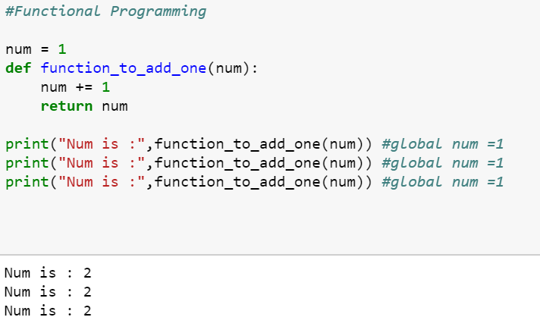
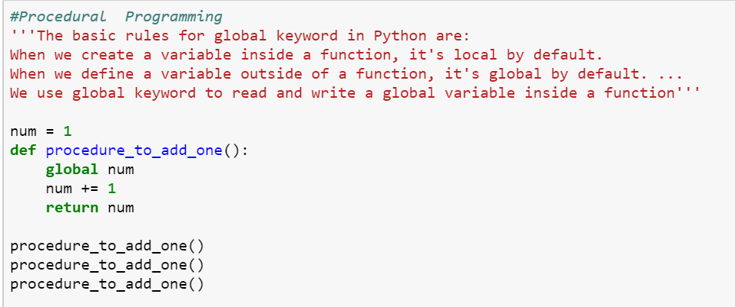
Functional Programming vs Procedure Programming

Slide 7
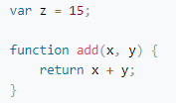
1. Pure functions
Pure functions always return the same results when given the same inputs. Consequently, they have no side effects.
Properties of Pure functions are:
First, they always produce the same output for same arguments irrespective of anything else.
Secondly, they have no side-effects i.e. they do modify any argument or global variables or output something.
A simple example would be a function to receive a collection of numbers and expect it to increment each element of this collection.
We receive the numbers collection, use map with the inc function to increment each number, and return a new list of incremented numbers.
Example:
def inc(x): Note : Function involving Reading files,
return x+1 using global data, random numbers are impure functions
list=[8,3,7,5,2,6]
x=map(inc,list) #print(list)
print(x)
Note: if a function relies on the global variable or class member’s data, then it is not pure. And in such cases, the return value of that function is not entirely dependent on the list of arguments received as input and can also have side effects.
A side effect is a change in the state of an application that is observable outside the called function other than its return value

Slide 8
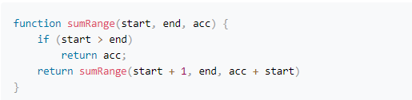
2. Recursion
In the functional programming paradigm, there is no for and while loops. Instead, functional programming languages rely on recursion for iteration. Recursion is implemented using recursive functions, which repetitively call themselves until the base case is reached.
The above code performs recursion task as the loop by calling itself with a new start and a new accumulator.

Slide 9
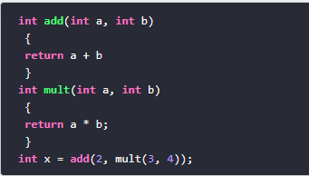
Referential transparency
An expression is said to be referentially transparent if it can be replaced with its corresponding value without changing the program's behaviour. As a result, evaluating a referentially transparent function gives the same value for fixed arguments. If a function consistently yields the same result for the same input, it is referentially transparent.
Functional programs don’t have any assignment statements. For storing additional values in a program developed using functional programming, new variables must be defined. State of a variable in such a program is constant at any moment in time
pure function + immutable date = referential transparency
Let’s implement a square function:
This (pure) function will always have the same output, given the same input.
Passing “2” as a parameter of the square function will always returns 4. So now we can replace the (square 2) with 4.

Slide 10

Immutability
In functional programming you cannot modify a variable after it has been initialized. You can create new variables and this helps to maintain state throughout the runtime of a program.
In imperative programming, this means “take the current value of x, add 1 and put the result back into x.” In functional programming, however, x = x + 1 is illegal. That’s because there are technically no variables in functional programming.
Using immutable data structures, you can make single or multi-valued changes by copying the variables and calculating new values,
Since FP doesn’t depend on shared states, all data in functional code must be immutable, or incapable of changing

Slide 11
Functions are First-Class and can be Higher-Order
A programming language is said to have First-class functions when functions in that language are treated like any other variable. For example, in such a language, a function can be passed as an argument to other functions, can be returned by another function and can be assigned as a value to a variable.
Higher-order functions are functions that take at least one first-class function as a parameter
Examples:
name_lengths = map(len, ["Bob", "Rob", "Bobby"])
Higher Order functions are map, reduce, filter
Functional style of getting a sum of a list:
new_lst = [1, 2, 3, 4]
def sum_list(lst):
if len(lst) == 1:
return lst[0]
else:
return lst[0] + sum_list(lst[1:])
print(sum_list(new_lst))
# or the pure functional way in python using higher order function
import functools
print(functools.reduce(lambda x, y: x + y, new_lst))

Slide 12
Functions are First-Class and can be Higher-Order
Map
map() can run the function on each item and insert the return values into the new collection. Example:
squares = map(lambda x: x * x, [0, 1, 2, 3, 4])
import random
names = ['Seth', 'Ann', 'Morganna']
team_names = map(lambda x: random.choice(['A Team','B Team']),names)
print names
// ['A Team', 'B Team', 'B Team']
reduce()
reduce() is another higher order function for performing iterations. It takes functions and collections of items, and then it returns the value of combining the items
Example:
sum = reduce(lambda a, x: a + x, [0, 1, 2, 3, 4])
print sum // 10

Slide 13
Functions are First-Class and can be Higher-Order ..cont
filter()
filter function expects a true or false value to determine if the element should or should not be included in the result collection. Basically, if the call-back expression is true, the filter function will include the element in the result collection. Otherwise, it will not.
Example:
def f(x):
return x%2 != 0 and x%3 ==0
filter(f, range(2,25))

Slide 14
Functional Programming – Non Strict Evaluation
In programming language theory, lazy evaluation, or call-by-need[1] is an evaluation strategy which delays the evaluation of an expression until its value is needed (non-strict evaluation) and which also avoids repeated evaluations
Allows Functions having variables that have not yet been computed
In Python, the logical expression operators and, or, and if-then-else are all non-strict. We sometimes call them short-circuit operators because they don't need to evaluate all arguments to determine the resulting value.
The following command snippet shows the and operator's non-strict feature:
>>> 0 and print("right")
0
>>> True and print("right")
Right
When we execute the preceding command snippet, the left-hand side of the and operator is equivalent to False; the right-hand side is not evaluated. When the left-hand side is equivalent to True, the right-hand side is evaluated

Slide 15
Functional Programming – lambda calculus
Lambda expressions in Python and other programming languages have their roots in lambda calculus. Lambda calculus can encode any computation. Functional languages get their origin in mathematical logic and lambda calculus
In Python, we use the lambda keyword to declare an anonymous function, which is why we refer to them as "lambda functions". An anonymous function refers to a function declared with no name.
when you want to pass a function as an argument to higher-order functions, that is, functions that take other functions as their arguments
Characteristics of Python lambda functions:
A lambda function can take any number of arguments, but they contain only a single expression. An expression is a piece of code executed by the lambda function, which may or may not return any value.
Lambda functions can be used to return function objects.
Syntactically, lambda functions are restricted to only a single expression.
Syntax:
lambda argument(s): expression
Example:
remainder = lambda num: num % 2 [(lambda x: x*x)(x) for x in [2,6,9,3,6,4,8]]
print(remainder(5))

Slide 16
Functional Programming – Closure
Basically, the method of binding data to a function without actually passing them as parameters is called closure. It is a function object that remembers values in enclosing scopes even if they are not present in memory.
Example:.
def counter(start=0, step=1):
x = [start]
def _inc():
x[0] += step
return x[0]
return _inc
c1 = counter()
c2 = counter(100, -10)
c1()
//1
c2()
90

Slide 17
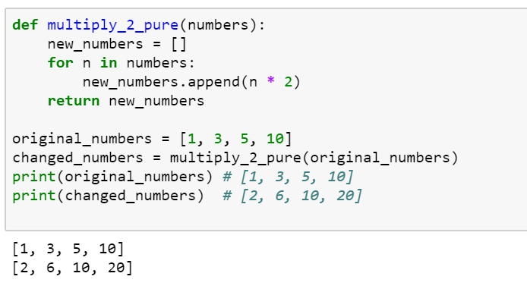
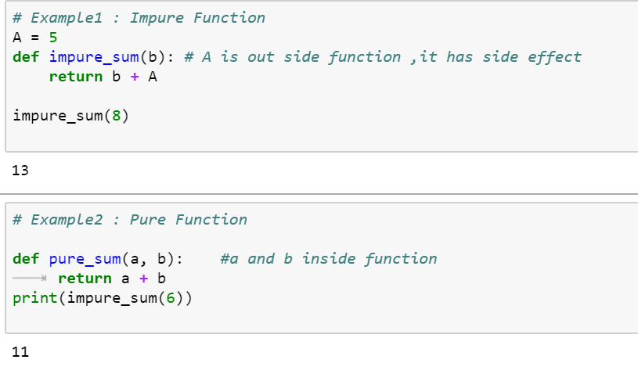
Pure Functions in Python
If a function uses an object from a higher scope or random numbers, communicates with files and so on, it might be impure

Slide 18
Built-in Higher Order Functions
Map
The map function allows us to apply a function to every element in an iterable object
Filter
The filter function tests every element in an iterable object with a function that returns either True or False, only keeping those which evaluates to True.
Combining map and filter
As each function returns an iterator, and they both accept iterable objects, we can use them together for some really expressive data manipulations!
List Comprehensions
A popular Python feature that appears prominently in Functional Programming Languages is list comprehensions. Like the map and filter functions, list comprehensions allow us to modify data in a concise, expressive way.

Slide 19
Anonymous Function
In Python, anonymous function is a function that is defined without a name.
While normal functions are defined using the def keyword, in Python anonymous functions are defined using the lambda keyword.
Characteristics of Python lambda functions:
A lambda function can take any number of arguments, but they contain only a single expression. An expression is a piece of code executed by the lambda function, which may or may not return any value.
Lambda functions can be used to return function objects.
Syntactically, lambda functions are restricted to only a single expression.
Syntax of Lambda Function in python
lambda arguments: expression
Example:
double = lambda x: x * 2 product = lambda x, y : x * y
print(double(5)) print(product(2, 3))
# Output: 10
Note: you want to pass a function as an argument to higher-order functions, that is, functions that take other functions as their arguments.

Slide 20
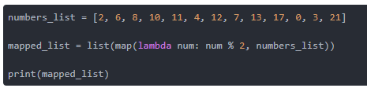
map() Function
Example Map with lambda
tup= (5, 7, 22, 97, 54, 62, 77, 23, 73, 61)
newtuple = tuple(map(lambda x: x+3 , tup))
print(newtuple)
//with multiple iterables
list_a = [1, 2, 3]
list_b = [10, 20, 30]
map(lambda x, y: x + y, list_a, list_b)
Example with Map
from math import sqrt
map(sqrt, [1, 4, 9, 16])
[1.0, 2.0, 3.0, 4.0]
map(str.lower, ['A', 'b', 'C'])
['a', 'b', 'c']
#splitting the input and convert to int using map
print(list(map(int, input.split(‘ ‘)))
Notes:
https://www.learnpython.org/en/Map%2C_Filter%2C_Reduce#:~:text=Map%2C%20Filter%2C%20and%20Reduce%20are,intricacies%20like%20loops%20and%20branching.

Slide 21
map() Function
map() function is a type of higher-order. As mentioned earlier, this function takes another function as a parameter along with a sequence of iterables and returns an output after applying the function to each iterable present in the sequence.
Syntax:
map(function, iterables)
Example without Map
my_pets = ['alfred', 'tabitha', 'william', 'arla']
uppered_pets = []
for pet in my_pets:
pet_=pet.upper()
uppered_pets.append(pet_)
print(uppered_pets)
Example with Map
my_pets = ['alfred', 'tabitha', 'william', 'arla']
uppered_pets=list(map(str.upper,my_pets)) print(uppered_pets)
//map with multiple list as input
circle_areas = [3.56773, 5.57668, 4.00914, 56.24241, 9.01344, 32.00013]
result = list(map(round, circle_areas, range(1,7)))
print(result)

Slide 22
filter() Function
filter extracts each element in the sequence for which the function returns True.
filter(), first of all, requires the function to return boolean values (true or false) and then passes each element in the iterable through the function, "filtering" away those that are false
Syntax:
filter(func, iterable)
The following points are to be noted regarding filter():
Unlike map(), only one iterable is required.
The func argument is required to return a boolean type. If it doesn't, filter simply returns the iterable passed to it. Also, as only one iterable is required, it's implicit that func must only take one argument.
filter passes each element in the iterable through func and returns only the ones that evaluate to true. I mean, it's right there in the name -- a "filter".
Example:
def isOdd(x): return x % 2 == 1
filter(isOdd, [1, 2, 3, 4])
# output ---> [1, 3]

Slide 23
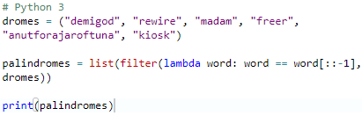
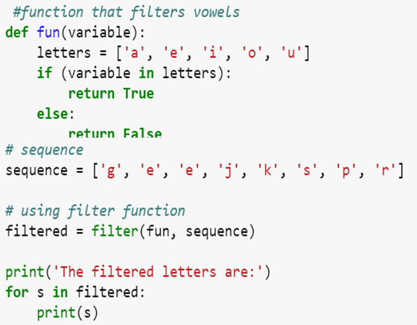
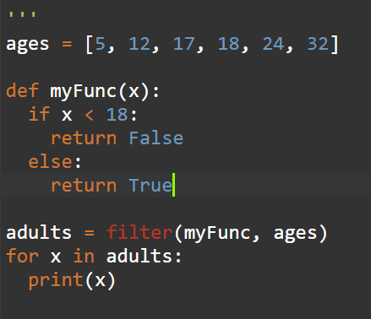
filter() Function
Example:
# Python 3
scores = [66, 90, 68, 59, 76, 60, 88, 74, 81, 65]
def is_A_student(score):
return score > 75
over_75 = list(filter(is_A_student, scores))
print(over_75)

Slide 24
reduce() Function
reduce, combines the elements of the sequence together, using a binary function. In addition to the function and the list, it also takes an initial value that initializes the reduction, and that ends up being the return value if the list is empty.
The “reduce” function will transform a given list into a single value by applying a given function continuously to all the elements. It basically keeps operating on pairs of elements until there are no more elements left.
reduce applies a function of two arguments cumulatively to the elements of an iterable, optionally starting with an initial argument
Syntax:
reduce(func, iterable[, initial])
Example:
reduce(lambda s,x: s+str(x), [1, 2, 3, 4], '')
#output '1234‘
my_list = [3,8,4,9,5]
reduce(lambda a, b: a * b, my_list)
#output 4320 ( 3*8*4*9*5)
from functools import reduce
y = filter(lambda x: (x>=3), (1,2,3,4))
print(list(y))
reduce(lambda a,b: a+b,[23,21,45,98])
nums = [92, 27, 63, 43, 88, 8, 38, 91, 47, 74, 18, 16,
29, 21, 60, 27, 62, 59, 86, 56]
sum = reduce(lambda x, y : x + y, nums) / len(nums)

Slide 25
map(), filter() and reduce() Function
Using filter() within map():
c = map(lambda x:x+x,filter(lambda x: (x>=3), (1,2,3,4)))
print(list(c))
Using map() within filter():
c = filter(lambda x: (x>=3),map(lambda x:x+x, (1,2,3,4))) #lambda x: (x>=3)
print(list(c))
Using map() and filter() within reduce():
d = reduce(lambda x,y: x+y,map(lambda x:x+x,filter(lambda x: (x>=3), (1,2,3,4))))
print(d)

Slide 26
map(), filter() and reduce() Function
from functools import reduce
# Use map to print the square of each numbers rounded# to two decimal places
my_floats = [4.35, 6.09, 3.25, 9.77, 2.16, 8.88, 4.59]
# Use filter to print only the names that are less than or equal to seven letters
my_names = ["olumide", "akinremi", "josiah", "temidayo", "omoseun"]
# Use reduce to print the product of these numbers
my_numbers = [4, 6, 9, 23, 5]
map_result = list(map(lambda x: round(x ** 2, 3), my_floats))
filter_result = list(filter(lambda name: len(name) <= 7, my_names))
reduce_result = reduce(lambda num1, num2: num1 * num2, my_numbers)
print(map_result)
print(filter_result)
print(reduce_result)

Slide 27
Examples
#print the sum of even numbers from the user input
import functools
l = input("Enter the list of numbers separated by space").split(" ")
l = map(int,l)
def even_fil(x):
flag = False
if x%2==0:
flag=True
return flag
even = list(filter(even_fil,l))
print(even)
s = functools.reduce(lambda x,y:x+y,even)

Slide 28
Examples
//Closure
def twice(x):
def square():
return x*x
return square()*square()
def quad(x):
return twice(x)
print(quad(3))

Slide 29
Examples
//partial to make some of the parameters as fixed
import functools
def s_total(a,b,c):
return a*b+c #a=5,b=15, c=from list
s = functools.partial(s_total,5,15)
l= [13,54,76,89,10]
for i in l:
print(s(i))

Slide 30
Function vs Procedure
S.No | Functional Paradigms | Procedural Paradigm
1 | Treats computation as the evaluation of mathematical functions avoiding state and mutable data | Derived from structured programming, based on the concept of modular programming or the procedure call
2 | Main traits are Lambda alculus, compositionality, formula, recursion, referential transparency | Main traits are Local variables, sequence, selection, iteration, and modularization
3 | Functional programming focuses on expressions | Procedural programming focuses on statements
4 | Often recursive. Always returns the same output for a given input. | The output of a routine does not always have a direct correlation with the input.
5 | Order of evaluation is usually undefined. | Everything is done in a specific order.
6 | Must be stateless. i.e. No operation can have side effects. | Execution of a routine may have side effects.
7 | Good fit for parallel execution, Tends to emphasize a divide and conquer approach. | Tends to emphasize implementing solutions in a linear fashion.

Slide 31
Function vs Object Oriented
S.No | Functional Paradigms | Object Oriented Paradigm
1 | FP uses Immutable data. | OOP uses Mutable data.
2 | Follows Declarative Programming based Model. | Follows Imperative Programming Model.
3 | What it focuses is on: "What you are doing. in the programme." | What it focuses is on "How you are doing your programming."
4 | Supports Parallel Programming. | No supports for Parallel Programming.
5 | Its functions have no-side effects. | Method can produce many side effects.
6 | Flow Control is performed using function calls & function calls with recursion. | Flow control process is conducted using loops and conditional statements.
7 | Execution order of statements is not very important. | Execution order of statements is important.
8 | Supports both "Abstraction over Data" and "Abstraction over Behavior." | Supports only "Abstraction over Data".

Slide 32
Logical Programming Paradigm

Slide 33
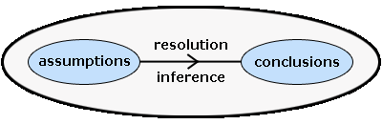
Logical Programming Paradigm
Logic programming is a paradigm where computation arises from proof search in a logic according to a fixed, predictable strategy. A logic is a language. It has syntax and semantics. More than a language, it has inference rules.
Syntax:
this is the rules about how to form formulas; this is usually the easy part of a logic.
Semantics:
About the meaning carried by the formulas, mainly in terms of logical consequences.
Inference rules:
Inference rules describe correct ways to derive conclusions

Slide 34
Logical Programming Paradigm
Logic :
A Logic program is a set of predicates.
Predicates :
Define relations between their arguments. Logically, a Logic program states what holds. Each predicate has a name, and zero or more arguments. The predicate name is a atom. Each argument is an arbitrary Logic term. A predicate is defined by a collection of clauses.
Clause :
A clause is either a rule or a fact. The clauses that constitute a predicate denote logical alternatives: If any clause is true, then the whole predicate is true.

Slide 35
Logical Programming Paradigm
Fact
A fact must start with a predicate (which is an atom). The predicate may be followed by one or more arguments which are enclosed by parentheses. The arguments can be atoms (in this case, these atoms are treated as constants), numbers, variables or lists.
Facts are axioms; relations between terms that are assumed to be true.
Example facts:
+big('bear')
+big('elephant')
+small('cat')
+brown('bear')
+black('cat')
+grey('elephant')
Consider the 3 fact saying ‘cat’ is a smallest animal and fact 6 saying the elephant is grey in color

Slide 36
Logical Programming Paradigm
Rule
Rules are theorems that allow new inferences to be made.
Describe Relationships Using other Relationships.
Example
Two people are sisters if they are both female and have the same parents.
Gives a definition of one relationship given other relationships.
Both must be females.
Both must have the same parents.
If two people satisfy these rules, then they are sisters (according to our simplified relationship)
dark(X)<=black(X)
dark(X)<=brown(X)
Consider rule 1 saying the animal color is black its consider to be dark color animal

Slide 37
Logical Programming Paradigm
Queries
A query is a statement starting with a predicate and followed by its arguments, some of which are variables. Similar to goals, the predicate of a valid query must have appeared in at least one fact or rule in the consulted program, and the number of arguments in the query must be the same as that appears in the consulted program.
print(pyDatalog.ask('father_of(X,jess)'))
Output:
{('jack',)}
X
print(father_of(X,'jess'))
Output:
jack
X

Slide 38
Anatomy Logical Programming Paradigm
X +male('adam')
son(X,Y)<= male(X) & parent(Y,X)
print(pyDatalog.ask('son(adam,Y)'))
Fact
Predicate
Clause
Query

Slide 39
Logical Programming Paradigm
from pyDatalog import pyDatalog
pyDatalog.create_atoms('parent,male,female,son,daughter,X,Y,Z')
+male('adam')
+female('anne')
+female('barney')
+male('james')
+parent('barney','adam')
+parent('james','anne')
#The first rule is read as follows: for all X and Y, X is the son of Y if there exists X and Y such that Y is the parent of X and X is male.
#The second rule is read as follows: for all X and Y, X is the daughter of Y if there exists X and Y such that Y is the parent of X and X is female.
son(X,Y)<= male(X) & parent(Y,X)
daughter(X,Y)<= parent(Y,X) & female(X)
print(pyDatalog.ask('son(adam,Y)'))
print(pyDatalog.ask('daughter(anne,Y)'))
print(son('adam',X))

Slide 40
Logical Programming Paradigm
pyDatalog.create_terms('factorial, N')
factorial[N] = N*factorial[N-1]
factorial[1] = 1
print(factorial[3]==N)

Slide 41
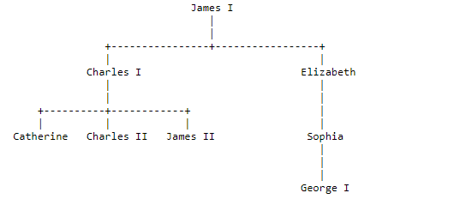
Logical Programming Paradigm

Slide 42
Logical Programming Paradigm
from pyDatalog import pyDatalog
pyDatalog.create_terms('X,Y,Z, works_in, department_size, manager, indirect_manager, count_of_indirect_reports')
# Mary works in Production
+works_in('Mary', 'Production')
+works_in('Sam', 'Marketing')
+works_in('John', 'Production')
+works_in('John', 'Marketing')
+(manager['Mary'] == 'John')
+(manager['Sam'] == 'Mary')
+(manager['Tom'] == 'Mary')
indirect_manager(X,Y) <= (manager[X] == Y)
print(works_in(X, 'Marketing'))
indirect_manager(X,Y) <= (manager[X] == Z) & indirect_manager(Z,Y)
print(indirect_manager('Sam',X))

Slide 43
Logical Programming Paradigm
Lucy is a Professor
Danny is a Professor
James is a Lecturer
All professors are Dean
Write a Query to reterive all deans?
Soln
from pyDatalog import pyDatalog
pyDatalog.create_terms('X,Y,Z,professor,lecturer, dean')
+professor('lucy')
+professor('danny')
+lecturer('james')
dean(X)<=professor(X)
print(dean(X))

Slide 44
Logical Programming Paradigm
likes(john, susie). /* John likes Susie */
likes(X, susie). /* Everyone likes Susie */
likes(john, Y). /* John likes everybody */
likes(john, Y), likes(Y, john). /* John likes everybody and everybody likes John */
likes(john, susie); likes(john,mary). /* John likes Susie or John likes Mary */
not(likes(john,pizza)). /* John does not like pizza */
likes(john,susie) :- likes(john,mary)./* John likes Susie if John likes Mary.
rules
friends(X,Y) :- likes(X,Y),likes(Y,X). /* X and Y are friends if they like each other */
hates(X,Y) :- not(likes(X,Y)). /* X hates Y if X does not like Y. */
enemies(X,Y) :- not(likes(X,Y)),not(likes(Y,X)). /* X and Y are enemies if they don't like each other */

Slide 45
Dependent Types Paradigms

Slide 46
Dependent Types Paradigms
Unit-IV (15 Session)
Session 6-10 cover the following topics:-
Dependent Type Programming Paradigm- S6-SLO1
Logic Quantifier: for all, there exists- S6-SLO2
Dependent functions, dependent pairs– S7-SLO 1
Relation between data and its computation– S7-SLO 2
Other Languages: Idris, Agda, Coq S8-SLO 1
Demo: Dependent Type Programming in Python S8-SLO2
Lab 11: Dependent Programming ( Case Study) ( S8)
Assignment : Comparative study of Dependent programming in Idris, Agda, Coq
TextBook:
Amit Saha, Doing Math with Python: Use Programming to Explore Algebra, Statistics,Calculus and More, Kindle Edition, 2015
URL :
https://tech.peoplefund.co.kr/2018/11/28/programming-paradigm-and-python-eng.html
https://freecontent.manning.com/a-first-example-of-dependent-data-types/

Slide 47
Introduction
A constant problem:
Writing a correct computer program is hard
Proving that a program is correct is even harder
Dependent Types allow us to write programs and know they are correct before running them.

Slide 48
What is correctness?
What does it mean to be “correct”?
Depends on the application domain, but could mean one or more of:
Functionally correct (e.g. arithmetic operations on a CPU)
Resource safe (e.g. runs within memory bounds, no memory leaks, no accessing unallocated memory, no deadlock. . . )
Secure (e.g. not allowing access to another user’s data)

Slide 49
What is Type?
In programming, types are a means of classifying values
Exp: values 94, "thing", and [1,2,3,4,5] → classified as an integer, a string, and a list of integers
For a machine, types describe how bit patterns in memory are to be interpreted.
For a compiler or interpreter, types help ensure that bit patterns are interpreted consistently when a program runs.
For a programmer, types help name and organize concepts, aiding documentation and supporting interactive editing environments.

Slide 50
Introductions
In computer science and logic, a dependent type is a type whose definition depends on a value.
It is an overlapping feature of type theory and type systems.
Used to encode logic's quantifiers like "for all" and "there exists".
Dependent types may help reduce bugs by enabling the programmer to assign types that further restrain the set of possible implementations.
Exp: Agda, ATS, Coq, F*, Epigram, and Idris

Slide 51
Dependent Type Example
Exp matrix arithmetic
Matrix type -→ refined it to include the number of rows and columns.
Matrix 3 4 is the type of 3 × 4 matrices.
In this type, 3 and 4 are ordinary values.
A dependent type, such as Matrix, is a type that’s calculated from some other values.
In other words, it depends on other values.
Definition
A data type is a type which is computed from a dependent other value.

Slide 52
Elements of dependent types
Dependent functions
The return type of a dependent function may depend on the value (not just type) of one of its arguments
For instance, a function that takes a positive integer n may return an array of length n, where the array length is part of the type of the array.
(Note that this is different from polymorphism and generic programming, both of which include the type as an argument.)
Dependent pairs
A dependent pair may have a second value of which the type depends on the first value

Slide 53
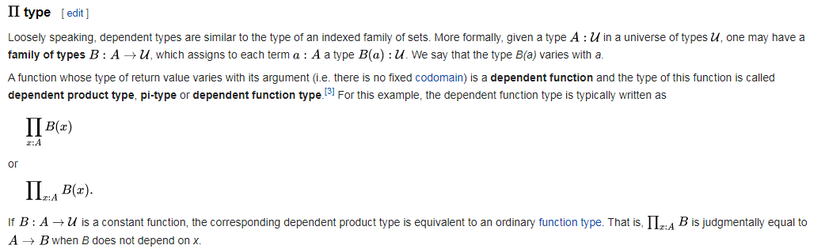
Formal definition

Slide 54
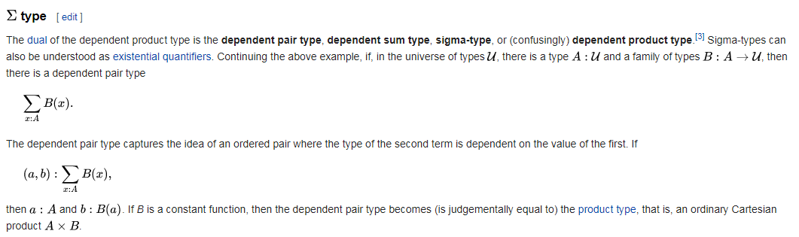
Formal definition

Slide 55
Pseudo-code
General Code
float myDivide(float a, float b)
{ if (b == 0)
return ???;
Else
return a / b;
}
Dependent Type Code
float myDivide3
(float a, float b, proof(b != 0) p)
{
return a / b;
}
Auto Checking done here

Slide 56
Python Simple Example
from typing import Union def return_int_or_str(flag: bool) -> Union[str, int]:
if flag:
return 'I am a string!‘
return 0
Notes:
https://dev.to/wemake-services/simple-dependent-types-in-python-4e14

Slide 57
Dependent Type
» pip install mypy typing_extensions
from typing import overload
from typing_extension import Literal
Literal
Literal type represents a specific value of the specific type.
from typing_extensions import Literal
def function(x: Literal[1]) -> Literal[1]:
return x
function(1)
# => OK!
function(2)
# => Argument has incompatible type "Literal[2]"; expected "Literal[1]"

Slide 58
Python Example
x :: Iterator[T1]
y :: Iterator[T2]
z :: Iterator[T3]
product(x, y) :: Iterator[Tuple[T1, T2]]
product(x, y, z) :: Iterator[Tuple[T1, T2, T3]]
product(x, x, x, x) :: Iterator[Tuple[T1, T1, T1, T1]]
All the above replaced by
def product(*args :Tuple[n]) -> Iterator[Tuple[n]]: pass

Slide 59
A first example: classifying vehicles by power source IDRIS Exampl
Listing 1 Defining a dependent type for vehicles, with their power source in the type (vehicle.idr)
data PowerSource = Petrol | Pedal ❶
data Vehicle : PowerSource -> Type where ❷
Bicycle : Vehicle Pedal ❸
Car : (fuel : Nat) -> Vehicle Petrol ❹
Bus : (fuel : Nat) -> Vehicle Petrol ❹
❶ An enumeration type describing possible power sources for a vehicle
❷ A Vehicle’s type is annotated with its power source
❸ A vehicle powered by pedal
❹ A vehicle powered by petrol, with a field for current fuel stocks

Slide 60
Listing 2 Reading and updating properties of Vehicle wheels : Vehicle power -> Nat ❶ wheels Bicycle = 2 wheels (Car fuel) = 4 wheels (Bus fuel) = 4 refuel : Vehicle Petrol -> Vehicle Petrol ❷ refuel (Car fuel) = Car 100 refuel (Bus fuel) = Bus 200 ❶Use a type variable, power, because this function works for all possible vehicle types. ❷ Refueling only makes sense for vehicles that carry fuel. Restrict the input and output type to Vehicle Petrol.
IDRIS Second Example

Slide 61
References
http://www.cs.ru.nl/dtp11/slides/brady.pdf
https://freecontent.manning.com/a-first-example-of-dependent-data-types/
https://en.wikipedia.org/wiki/Dependent_type
https://livebook.manning.com/book/type-driven-development-with-idris/chapter-1/13
https://github.com/python/mypy/issues/366
https://www.learnpython.org/en/Map%2C_Filter%2C_Reduce#:~:text=Map%2C%20Filter%2C%20and%20Reduce%20are,intricacies%20like%20loops%20and%20branching.

